Slide 1
React Hook

Slide 2
Objectives
Introducing Hook
Use State Hook
Use Effect Hook
Rules of Hook
Custom Hook

Slide 3
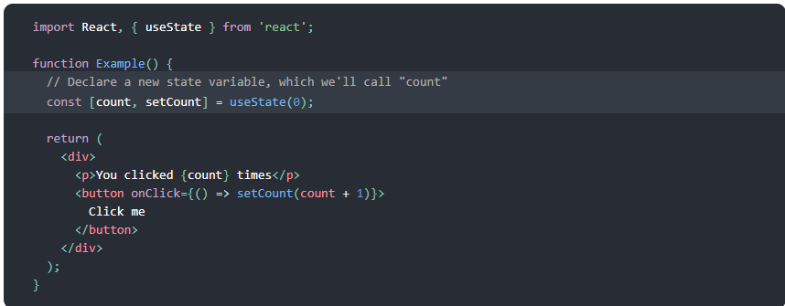
Introducing Hook
Hooks are a new addition in React 16.8.
Hook let you use state and other features of react without class.
Notes:
Explaining a little bit about class Component and function Component. Explaining the above example, indicate that where Hook used in this example

Slide 4
Introducing Hook (2)
What is Hook?
Hooks are functions that let you “hook into” (work with) React state and lifecycle features from function components.
Hooks don’t work inside classes — they let you use React without classes.
They include:
Basic: useState(), useEffect(), useContext()
Additional functions: useReducer(), useCallback(), useMemo(), useRef(), useImperativeHandle(), useLayoutEffect(), useDebugValue()
useState() and useEffect() are the most important function.
Notes:
Explaining a little bit about class Component and function Component

Slide 5
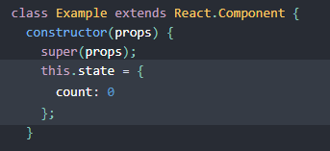
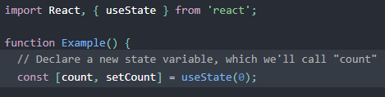
Use State Hook
Let’s see which different things between Hook and “no Hook”
Class Component
Function Component

Slide 6


Use State Hook (2)
Use state and set state with “no Hook”
Use state and set state with useState() in Hook
Notes:
Give some example about using multiple useState()

Slide 7
Use State Hook (3)
Notice:
Don’t set props value or immutable value in useState():
Don’t: const [user, setUser] = useState(props.userData);
Should: const [user, setUser] = useState({ name: ‘user' });
Just update state with value from side effect in useEffect():
useEffect(() => {
setUser(props.userData)
}, [props.userData])
Notes:
Give some examples about notice

Slide 8
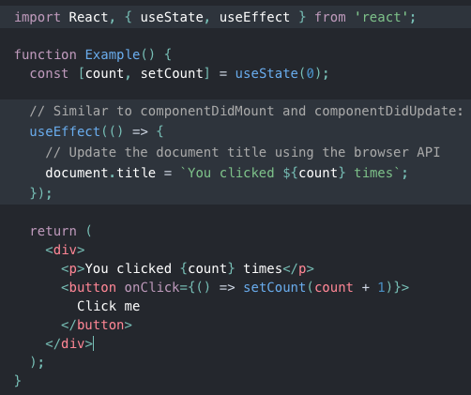
Use Effect Hook
Effect Hook lets you perform side effects in function component. It work similarly as React class lifecycle methods. However, there are some differences.
Only one functions useEffect() can replace all lifecycle methods: componentDidMount(), componentDidUpdate(), componentWillUnmount()
Notes:
Give some example about using multiple useEffect()

Slide 9
Use Effect Hook (2)
Class methods: componentDidMount()
Hook: useEffect(() => {
// you can write code in componentDidMount in here
}, [])
Class methods: componentDidUpdate()
Hook: useEffect(() => {
// you can write code in componentDidUpdate in here
}, [propsObserved, stateObserved, variableObserved])
Notes:
Give some example about [propsObserved, stateObserved, variableObserved]

Slide 10
Use Effect Hook (3)
Class methods: componentWillUnmount()
Hook: useEffect(() => {
return() => {
// you can write code in componentWillUnmount in here
}
}, [propsObserved, stateObserved, variableObserved])
Example: getUserData sẽ chỉ gói 1 lần duy nhất sau khi render
useEffect(() => {
UserServer.getUserData();
}, [])
Notes:
Give some example about [propsObserved, stateObserved, variableObserved]

Slide 11
Rules of Hook
Hooks are JS functions, they are quite simple and easy to use, but we have to follow 2 rules when using them:
Only Call Hooks at the Top Level:
Don’t call Hooks inside loops, conditions, or nested functions, because it result in rendering infinite. Instead, always use Hooks at the top level of your React function.
Only Call Hooks from React Functions:
Don't call Hooks from regular JS functions. Instead, you must call Hooks from React function components. In addition, can call hooks from custom Hooks
Notes:
Give some example about [propsObserved, stateObserved, variableObserved]

Slide 12
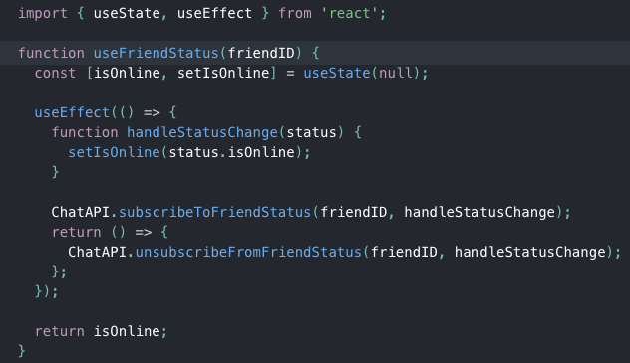
Custom Hooks
Creating your own hooks:
Anywhen we wanna share logic between JS functions, we can consider to create your hook
A custom Hook is a JS function whose name starts with “use" and that may call other Hooks
Notes:
Give some example about [propsObserved, stateObserved, variableObserved]

Slide 13
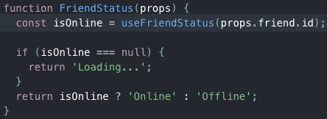
Custom Hooks (2)
As you can see in above example:
Custom Hook functions is written as function Component, but it return state instead of Component or regular variable.
You can use it as a JS function, pass parameter and get return value.
Custom Hook is very interesting thing in Hooks. However, you should practice with useState, useEffect carefully before you start to custom Hook
Notes:
Give some example about [propsObserved, stateObserved, variableObserved]

Slide 14
Conclusion
Hook is another way to use React features
It is only used in function Component
Hooks are functions, include: useState, useEffect, …
Almost functions in class lifecycle can be handled by useEffect
You can create your own Hook by “custom Hook”
Last but not least, Hook is recommended to use by React Creator
Reference: Hooks API Reference – React
Notes:
Give some example about [propsObserved, stateObserved, variableObserved]

